Slide 1


FARM INCOME
DIVERSIFICATION PROGRAMME
STABEX CASSAVA PROJECT
NKHATA-BAY DISTRICT OFFICE
==================================================
STABEX: SUPPORT TO CASSAVA PROJECT
____________________________________________________________________________
PROGRESS REPORT FROM JULY 09-DEC 2010

Slide 2
PROJECT OBJECTIVE
The overall development objective to which the project, and therefore this programme estimate, is intended to contribute is to reduce rural poverty in the district and increase their incomes by 10%.

Slide 3
PROJECT PURPOSE
The project purpose is to improve the production, processing and marketing of cassava in the targeted cassava belts of Tukombo, Chintheche and Limphasa EPAs of the district

Slide 4
Support and Management
The STABEX Support to Cassava Project was funded by the European Development Fund (EDF) of the European Union (EU) but managed and implemented by Farm Income Diversification Programme (FIDP) under the Ministry of Agriculture and Food Security (MoAFS) whose project Co-ordinator was based in Nkhotakota at the District Agriculture Office

Slide 5
TARGET AREAS AND BENEFICIERIES
STABEX: Support to Cassava Project was being implemented in Tukombo, Chintheche, Limphasa and Nkhata-bay EPAs. The targeted beneficiaries were 1500 and all were identified during the second quarter of 2009-10 farming season.

Slide 6
Major field activities of the project since July 09-Dec 2010
Formation of 75 cassava farmer groups of 20 members each
Conducted membership verification exercise to all groups to determine the genuine existence of the groups and their members.
Conducted a baseline survey of sampled 375 cassava project farmers out of 1493 identified farmers to act as a basis for determination of achieving one of the project (10℅ increase in household incomes).

Slide 7
Major activities cont’n
Provided information to farmers on cassava varieties recommended for HQCF(High Quality Cassava Flour) and Starch. These varieties are Sauti, Silira, Yizaso and Sagonja.
Conducted market survey for farmers’ cassava products of HQCF and Starch.
Conducted staff and Farmer training in Cassava seed and root production, Cassava processing into starch and HQCF as well as group Dynamics and Agribusiness activities.

Slide 8
Major activities cont’n
28 staff members were trained in cassava root processing into High Quality Cassava Flour and Starch making.
Distributed 990 cassava cuttings bundles to 20 individual cassava seed multipliers.
Distributed more than 9000 bundles of cassava cuttings to cassava root producers through NASFAM an Agricultural Organisation that won the tender to supply the cassava planting materials to the project in 2009/2010 season.

Slide 9
Major activities cont’n
Participated in 4 review meetings at National level.
Facilitated the following joint field visits with some of the Officials involved in the project:
-November 2009 with the National STABEX Project Coordinator
-March 2010, with the Deputy Director of Crops Development
-March 2010, with the Imprest Administrator
-In May 2010, with the Farm Income Diversification Project (FIDP) ---Programme manager European Union (EU) Delegate
-In May 2010, with the Deputy Director responsible for Horticulture
-In August,2010 with the Imprest Administrator

Slide 10
Major activities cont’n
Distributed 22 mountain Bikes to frontline staff and to 3 Lead farmers to ease mobility.
Also distributed some farm inputs as indicated in the table of received items.
Conducted orientation of 20 cassava seed multipliers that was held at Chintheche EPA.
Participated in agribusiness training for 26 Nkhata-Bay District staff from 2nd to 4th August 2010.

Slide 11
Major activities cont’n
Participated in farmer and staff tour to Banga, Usufu and Masinda in Nkhota-Kota District and Blantyre on group organization, and cassava processing and marketing
Facilitated Cassava seed assessment and verification exercise.
Identification of the 2010/2011 season cassava seed beneficiaries.

Slide 12
Major activities cont’n
Participated in cassava field inspections.
Supervision of construction of cassava processing and building structure at Chombe

Slide 13
KEY RESULT AREAS
There were three result areas as follows:
Incomes of beneficiaries were to be increased by 10%
A greater percentage of cassava to be processed for value addition without affecting their food security as the district largely depends on cassava.
The production of various types of cassava brought in line with identified markets of High Quality Cassava Flour and Starch.

Slide 14
MAIN AREAS OF INTERVENTION
Nkhata Bay is one of the major cassava producing areas in Malawi.
As such, the project’s main areas of focus were mostly on :
1.Improving cassava production: the sub activities include:-
Providing smallholders with improved varieties
Providing smallholders with inputs (fertilizers, pesticides and tools)
Capacity building to staff and training of farmers in cassava seed production, cassava root production and cassava root processing into High Quality Cassava Flour (HQCF) and Starch.
Providing smallholders with market information on which Cassava varieties (Sauti, Sagonja, and Yizaso) to produce for specific markets for HQCF and Starch.

Slide 15
AREAS OF INTERVANTION CONT’N
2. Increasing cassava processing: the sub areas of intervention include:
Providing smallholders with processing equipment (drying, chipping, and milling) with emphasis to three processing groups, one in each EPA.
Capacity building and training of farmers in processing and agribusiness
3. Identifying markets for cassava: the sub activities include
Conducting a marketing study of existing and potential markets for cassava products at district, national and international level
Dissemination of market information to farmers to enable them make a rational decision in cassava production
Exchanging and coordinating information: sub activities include
Facilitating an exchange of information between stakeholders in the sector STABEX farmer beneficiaries , Cassava products using industries, projects involved in cassava activities like Total Land Care and CAVA)
Identifying future priorities for cassava development in the district and national level.

Slide 16
TARGETS AND ACHIEVEMENTS IN RELATION TO AREAS OF INTERVENTION
Activity | EPA | Target | Achieved | Beneficiaries | Remarks
1.Providing smallholder farmers with improved cassava varieties | Tukombo | 2000 bundles | 3476 bundles | 600 farmers(345 F,255M) | Sauti variety
 | Chintheche | 8000 bundles | 7893 bundles | 760 farmers(490 F,270M) | Sauti,Izaso varieties
 | Nkhata-bay | 1500 bundles | 2247 bundles | 330 farmers(190F,140M) | Sauti,Izaso varieties
 | Limphasa | 1800 bundles | 2354 bundles | 420 farmers(256F,164M)

Slide 17
TARGETS AND ACHIEVEMENTS cont’n
Activity | EPA | Target | Achieved | Beneficieries | Remarks
2. Increasing Cassava Processing | Limphasa/Chombe section | 210 MT of starch/year | 0 MT | 13 Farmers | The machine is not yet electrified, but payments were done only waiting for ESCOM.

Slide 18
TARGETS AND ACHIEVEMENTS cont’n
3.Identifying markets for cassava
Markets have been identified in the following companies:
Packaging Industries,starch requirement 240Mt.
Raiply Mw Ltd,starch requirement 70Mt.
Korean Industries starch requirement 180Mt.

Slide 19
Items distributed to EPAs
EPA NAME | ITEMS | QUANTITY | REMARKS
Tukombo | Sprayers | 2
 | Weighing scales | 2 | For home stead processing
 | Basins for starch making | 25 | For home stead processing
 | Hoes | 80
 | Fertilizer | 50 bags | For seed multipliers
 | Panga Knives | 30
 | Cutlass(mphopo) | 50
 | Sieves | 26 | For home stead processing

Slide 20
Items distributed to EPAs cont’n
EPA NAME | ITEM | QUANTITY | REMARKS
Chintheche | Sprayers | 4
 | Weighing scales | 2 | For home stead processing
 | Basins for starch making | 26 | For home stead processing
 | Hoes | 80
 | Fertilizer | 120 bags | For seed multipliers
 | Panga Knives | 69
 | Cutlass(mphopo) | 80
 | Sieves | 26 | For home stead processing

Slide 21
Items distributed to EPAs cont’n
EPA NAME | ITEM | QUANTITY | REMARK
Nkhata-bay | Sprayers | 2
 | Weighing scales | 2 | For home stead processing
 | Basins for starch making | 1 | For home stead processing
 | Hoes | 4
 | Fertilizer | 36 bags | For seed multipliers
 | Panga Knives | 5
 | Cutlass(mphopo) | 5
 | Sieves | 1 | For home stead processing

Slide 22
Items distributed to EPAs cont’n
EPA NAME | ITEM | QUANTITY | REMARK
Limphasa | Sprayers | 3
 | Weighing scales | 2 | For home stead processing
 | Basins for starch making | 26 | For home stead processing
 | Hoes | 69
 | Fertilizer | 66 bags | For seed multipliers
 | Panga Knives | 48
 | Cutlass(mphopo) | 60
 | Sieves | 26 | For home stead processing

Slide 23
Challenges
The district has no project vehicle/motor cycle for smooth running of project activities
The district has no project computer to facilitate compilation of reports.
Short life span of the project.
Machine for starch processing has not been installed.
Need for start up capital for a processing group at Chombe

Slide 24
Recommendations
The Project should allocate a vehicle to the district.
The project should allocate a computer to the district for easy writing of reports.
The project should find a caretaker (FIDP) to continue with the remaining activities(processing).
ESCOM should electrify the building for processing.
FIDP to give in a start-up to the processing group.

Slide 25
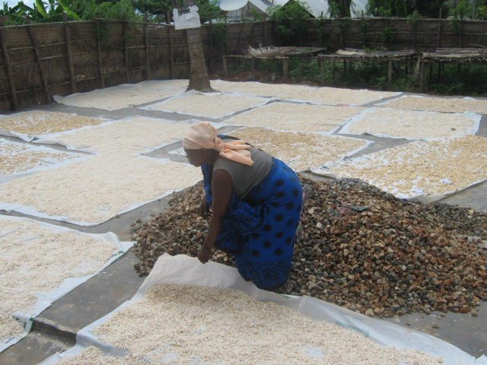
THANK YOU

